Slide 1
BAN 502 – Module 6 Unsupervised Learning & Clustering
Dr. Avinash Geda

Slide 2
Unsupervised Learning
X1 | X2 | Xn | Y
65 | … | … | Yes
51 | … | … | No
45 | … | … | Yes
55 | … | … | Yes
59 | … | … | Yes
69 | … | … | No
Supervised Learning
Known values for Xs and Y

Slide 3
Unsupervised Learning
X1 | X2 | Xn
65 | … | …
51 | … | …
45 | … | …
55 | … | …
59 | … | …
69 | … | …
Unsupervised Learning
Known values for Xs
No Labeling or Classifications

Slide 4
Unsupervised Learning
Identify Patterns in Data
Examples
Customer Segmentation
Recommendations
Text Clustering

Slide 5
Clustering
k-Means Clustering
Partitions data into k clusters
Objective: Each cluster contains observations that are as similar as possible
Clusters are represented by their center
Distance typically Euclidean (alternatives exist)
Requires:
No missingness
Scaled data (mean = 0, standard deviation =1)

Slide 6
Clustering
k-Means Clustering
Algorithm
1. Select number of clusters
2. Randomly select k observations as starting cluster centers
3. Assign observations to closest center
4. Calculate new center of each cluster
5. Repeat Step 3 and 4 until clusters are stable or after a set number of iterations

Slide 7
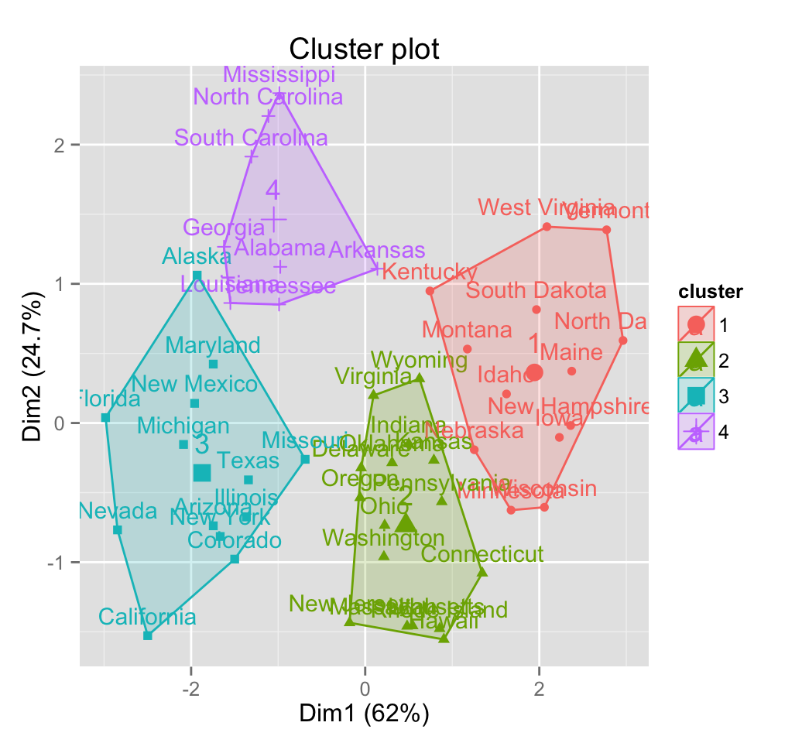
Clustering in Software

